Slide 1
YOU SAY ILLEGAL, I SAY LEGITIMATE: ENTREPRENEURSHIP IN THE INFORMAL
ECONOMY
_x0001_ Academy of Management Review 2009, Vol. 34, No. 3, 492–510.
BY: JUSTIN W. WEBB
LASZLO TIHANYI
R. DUANE IRELAND
DAVID G. SIRMON
Texas A&M University
By: Dr. Tariq Yousafzai

Slide 2
Introduction
Institutions
Include any form of constraint (formal or informal) that human beings devise to shape their interaction
reduce uncertainty by establishing a stable structure to human interaction
For example
organizations
rules, conventions, norms, etc.

Slide 3
Introduction
The study develops theoretical arguments examining the entrepreneurial process in the informal economy and the ability of some entrepreneurs to thrive outside formal institutional boundaries.
The study further draws three theoretical levels to develop arguments for describing the contextual nature of the entrepreneurial process and integrate Micro-level (individual), Macro-level (institutional), and Meso-level (group) effects.

Slide 4
Legal Vs Legitimate
Societies are composed of groups that often have different opinions about what is socially acceptable (Bickford, 1999; Rokeach, 1973).
Groups in a society have twofold understanding
  What is legal—as specified by laws and regulations—and
  What they consider to be Legitimate—as specified by norms, values, and beliefs (Dowling & Pfeffer, 1975; Scott, 1995).

Slide 5
The Roots of legal framework
Different norms, values, and beliefs are the source of these differences across the world.
One group’s norms, values, and beliefs may eventually become the basis of laws and laws and regulations may differ from the laws and regulations that would be the product of another large group’s norms, values, and beliefs (Weber, 1978).
The Police Act of 1860 in Pakistan was used for British Rule with certain confidential clauses

Slide 6

The Gap between Legal and Legitimate
  Because of these differences, a gap often exists between what some large groups in a particular society understand to be legal—as specified by laws and regulations—
  and what they consider to be legitimate—as specified by norms, values, and beliefs (Dowling & Pfeffer, 1975; Scott, 1995).

Slide 7
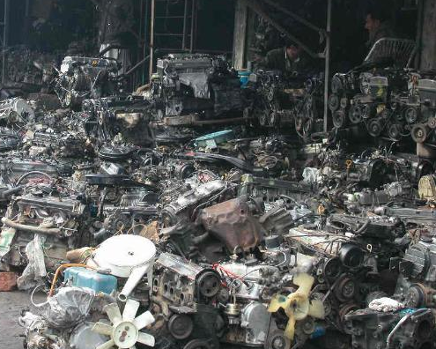
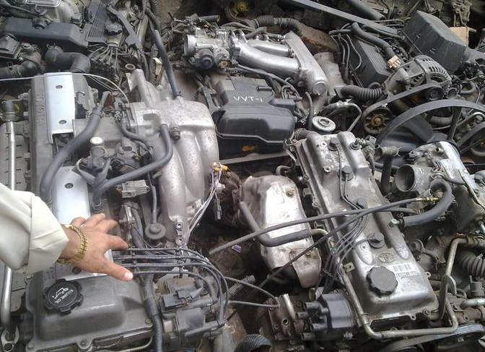
Emergence of informal economy
A gap (or variance) between what is legal in a society and what some large groups consider to be legitimate in that society allows an informal economy to emerge.

Slide 8

Defining informal economy
We define the informal economy as the set of illegal yet legitimate (to some large groups) activities through which actors recognize and exploit opportunities (Castells & Portes, 1989; Feige, 1990).
Street vendors selling cookies
Working below standard wages
Informal economy is nether taxed nor
monitored by any form of Government

Slide 9
Opportunity in informal sector
In this context an opportunity is the potential to create more efficient or effective means— that is, production/distribution—and/or ends— that is, goods/services
The illegality of these activities surfaces because the means and/or ends employed do not comply with the mandates of laws (e.g., not adhering to labor laws) and regulations.
Indian medicine sold out in Bara Market Peshawar
Chinese labor practices in violation of H. rights

Slide 10
Legitimate economy
Some groups may deem these activities to be socially acceptable/legitimate when they are consistent with those groups’ norms, values, and beliefs.
    E.g. Activities involving undocumented workers (Raijman, 2001; Villar, 1994), and music/software piracy (Givon, Mahajan, & Muller, 1995)
  Thus these entrepreneurs are still abiding by the boundaries of informal institutions

Slide 11
Illegal entrepreneurs or narrow legality?
By default, entrepreneurial activities outside formal institutional boundaries are illegal.
Formal institutions condemn the exploitation of a set of opportunities by deeming them illegal (Jepperson, 1991; Scott, 1995), a realm of opportunities exists for entrepreneurs willing to operate outside formal institutional boundaries

Slide 12
Meso-Level
Based on collective identity theory (Lounsbury & Glynn, 2001; Polletta & Jasper, 2001) at the meso level, authors show how entrepreneurs rely on cooperative groups to recognize and exploit opportunities in the informal economy.
These cooperative groups form through a shared identification with similar others or through a shared disidentification with formally institutionalized practices.

Slide 13
Meso-Level
The collective identity theory lens suggests how and why informal economy entrepreneurs create and access markets that substitute for the lack of support from formal institutions.
Formal institutions require collateral

Slide 14
Order of arguments in the Paper
First, the authors establish the theoretical context for their arguments at the micro, meso, and macro levels.
They then form propositions to discuss how institutional incongruence and weak enforcement of formal institutions enable the entrepreneurial process in the informal economy, how collective identity facilitates opportunity recognition and exploitation in the informal economy, and what the influences are that affect the transition from the informal to the formal economy.

Slide 15
THEORETICAL BACKGROUND
The Entrepreneurial Process
The activities in entrepreneurial process unfold in stages to realize the opportunity's potential
Entrepreneurial alertness
Opportunity recognition
Opportunity exploitation
Decisions concerning growth

Slide 16
THEORETICAL BACKGROUND
The Entrepreneurial Process
Entrepreneurial alertness (individual’s ability to recognize opportunities)
Opportunity recognition (evaluate ideas concerning specific market needs)
Opportunity exploitation (gather, bundle, and leverage new and existing resources in order to develop more efficient means and/or ends)
Decisions concerning growth (through same opportunity in additional markets and/or different opportunities in the same market.)

Slide 17
THEORETICAL BACKGROUND
Institutional Boundaries of the Informal Economy
Legitimacy: a generalized perception or assumption that the actions of an entity are desirable, proper, or appropriate within some socially constructed system of norms, values, beliefs, and definitions”
Consequently, institutions “negatively constrain action, define opportunity, and facilitate patterns of interactions”

Slide 18
THEORETICAL BACKGROUND
Institutional Boundaries of the Informal Economy
Thus, institutions confer legitimacy to sanctioned opportunities to promote socially acceptable actions (Jepperson, 1991) and simultaneously specify unsanctioned opportunities.
The distinction between formal laws/regulations and values, norms, and beliefs establishes the informal economy’s context

Slide 19
THEORETICAL BACKGROUND
Institutional Boundaries of the Informal Economy
F: Laws, regulations, and their supporting apparatuses (enforcement agencies, regulatory bodies and incentives etc.) establish boundaries for the entrepreneurs.
IF: Norms, values, and beliefs that define socially acceptable behaviour; encourage conformity with social groups’ shared norms, values, and beliefs (Aldrich & Baker, 2001).

Slide 20
THEORETICAL BACKGROUND
Institutional Boundaries of the Informal Economy
Means and/or ends of an opportunity can be assigned classifications of both legality and legitimacy.
Means are factors (raw materials, labor, and other inputs) and pro­cesses (pri­mary activities, such as inbound logistics, oper­ations, outbound logistics, marketing and sales, and service) directly involved in the production of fin­ished goods and services.
Ends are output (goods or services) produced by the venture.

Slide 21
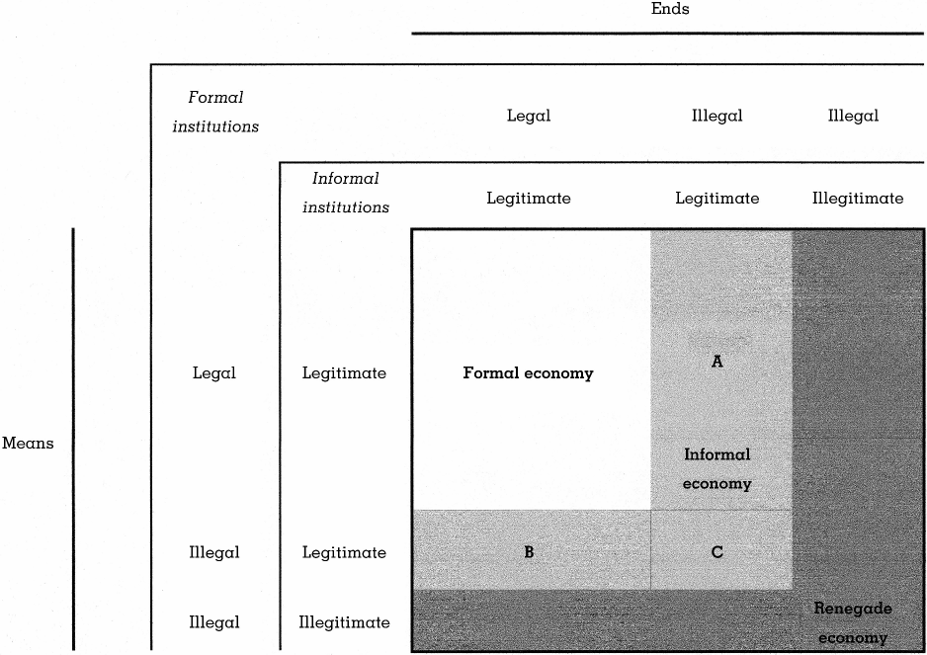
THEORETICAL BACKGROUND
Institutional Boundaries of the Informal Economy
Institutional Categories of Entrepreneurial Activities (FIGURE 1)

Slide 22
THEORETICAL BACKGROUND
Institutional Boundaries of the Informal Economy
Assignment No (1) Entrepreneurship
How has this part of theoretical framework crafted?
Apply this discussion in Pakistani context. You should exemplify the various types of economies and their supportive means and ends through indigenous examples.
This is a creative assignment and as such do not ask for any further guidance. Use your own creative imagination.
The deadline for this assignment is Monday 24 September, 2018. Assignments submission after due date is not allowed.
The assignment should not exceed more than two pages. Similarity in assignments will not be tolerated at all.
This assignment targets one of the CLOs

Slide 23
THEORETICAL BACKGROUND
Institutional Boundaries of the Informal Economy
The informal economy couples illegality with legitimacy: Aactivities to recognize and exploit opportunities occurring outside formal institutional boundaries but within informal institutional boundaries (e.g. use undocumented workers in cafe)
Three cases: A, B and C

Slide 24
Institutional Boundaries of the Informal Economy (Cont…)
Case A represents the combination of illegal yet legitimate ends with legal and legitimate means. Therefore, concerns for Case A revolve around the good or service itself, not its production.
Case B combines legal and legitimate ends with illegal yet legitimate means.
Case C combines both means and ends that are illegal yet legitimate.
Notes:
Case A examples here include pirated software and counterfeit products. The means associated with making copies of compact discs or counterfeit products are not illegal; however, the ends produced by those means are illegal. Selling drugs with medicinal purposes that have regulatory approval in other countries but not in a focal country is another example of Case A activities.
Case B examples includes employing undocumented workers. While undocumented workers may provide services similar to those of documented workers, they may be willing to accept lower wages and work without benefits conditions that increase operational efficiency.
Case C examples includes using undocumented workers to produce counterfeit products is an example of this type of entrepreneurial activity

Slide 25

Section B Done uptill here on 11/2/2019

Slide 26
THEORETICAL BACKGROUND
Collective Identity and the Entrepreneur in the Informal Economy
Informal economy emerges due to lack of access to the resources and to the markets available within the boundaries of formal institutions
They rely on Collective identity, the common bond tying individuals to a group (Polletta & Jasper, 2001)
Identi­fication: individual’s cognitive, moral, or emotional attachment to a group based on similar attributes (Nahapiet & Ghoshal, 1998) such as values, behaviors, race ETC

Slide 27
THEORETICAL BACKGROUND
Collective Identity and the Entrepreneur in the Informal Economy
Through discourse (differing modes of communication, e.g. con­versation, text, pictures, and symbols common identities are forged and collective action is mobilized).
YELLA YELLA AKHI
Tatoos

Slide 28
A MULTILEVEL FRAMEWORK OF THE ENTREPRENEURIAL PROCESS IN THE INFORMAL ECONOMY
Institutions
Based on the theoretical context given here, authors develop propositions specifying the relationships among institutions, collective identity, and the entrepreneurial process in the informal economy.

Slide 29
A MULTILEVEL FRAMEWORK OF THE ENTREPRENEURIAL PROCESS IN THE INFORMAL ECONOMY
Institutions
Entrepreneurial alertness increases the recognition of opportunities (Kirzner, 1979) but institutions play a role in this relationship as well.
Incongruence between formal and informal institutions exert an important effect on entrepreneurs’ recognition of opportunities in the informal economy.

Slide 30
A MULTILEVEL FRAMEWORK OF THE ENTREPRENEURIAL PROCESS IN THE INFORMAL ECONOMY
Institutions
Differences in institutional boundary conditions is called institutional incongruence and arises
When formal and informal institutions send different signals about the acceptability of certain means and/or ends as the foundations for entrepreneurial activities.
Normally the basis are found in more restrictive nature of formal institutions as compared to informal

Slide 31
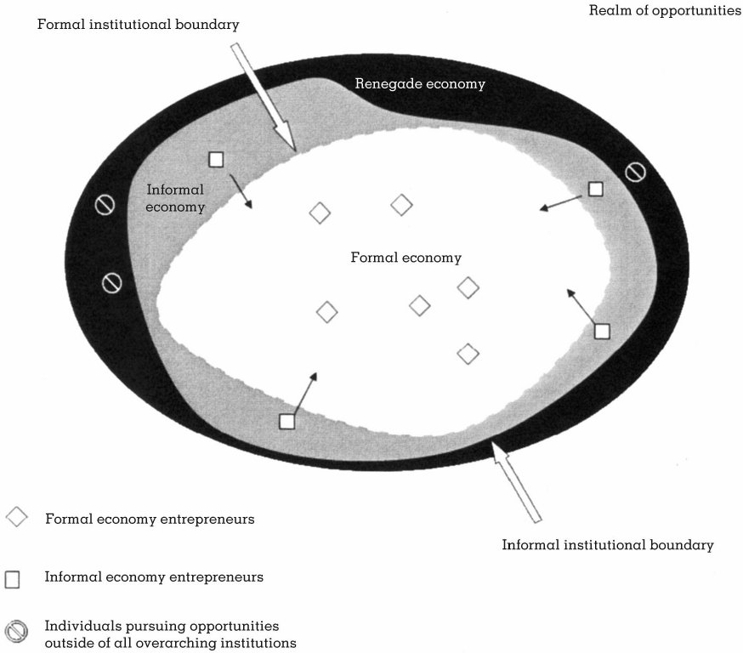
A MULTILEVEL FRAMEWORK OF THE ENTREPRENEURIAL PROCESS IN THE INFORMAL ECONOMY
Institutions
FIGURE 2
Locus of the Formal, Informal, and Renegade Economies and Their Participants

Slide 32
A MULTILEVEL FRAMEWORK OF THE ENTREPRENEURIAL PROCESS IN THE INFORMAL ECONOMY
The boundaries of formal economy can be increased to minimize informal by two ways:
Realizations by legislative process and Lobbying by interest groups for recognition
Proposition 1: Institutional incongruence strengthens the relationship between entrepreneurial alertness and opportunity recognition in the in formal economy.

Slide 33
A MULTILEVEL FRAMEWORK OF THE ENTREPRENEURIAL PROCESS IN THE INFORMAL ECONOMY
Weak Enforcement of Formal Institutions
Stability of formal institutions is a function of surveillance or enforcement power (Scott, 1995).
The state’s enforcement of formal regulations is third-party enforcement which ideally implies neutrality, costless measurement of contracts, and costless enforcement (North, 1990).
In reality enforcement costs are substantial and can exceed the value created through them

Slide 34
A MULTILEVEL FRAMEWORK OF THE ENTREPRENEURIAL PROCESS IN THE INFORMAL ECONOMY
Weak Enforcement of Formal Institutions
Proposition 2:
Weak enforcement of formal institutions strengthens the re­lationship between opportunity recognition and opportunity exploitation in the informal economy

Slide 35
A MULTILEVEL FRAMEWORK OF THE ENTREPRENEURIAL PROCESS IN THE INFORMAL ECONOMY
Collective Identity and Opportunity Recognition in the Informal Economy
The collective identity strengthens over time as the group behaves in ways to protect and reinforce its defining characteristics in the face of broader contextual changes (Polletta & Jasper, 2001).
Norms, values, and beliefs that develop in the collective identity of such groups can differ from the prescriptions put forth by formal institutions.

Slide 36
A MULTILEVEL FRAMEWORK OF THE ENTREPRENEURIAL PROCESS IN THE INFORMAL ECONOMY
Collective Identity and Opportunity Recognition in the Informal Economy
Membership in a collective identity that is outside formal institutions, individuals may recognize opportunities through three types of valuable experiential knowledge:
(1) A market of opportunities exists outside formal institutions,
(2) Collective identity members’ needs and customer problems, and
(3) How to serve the needs of the collective identity (Shane, 2000).

Slide 37


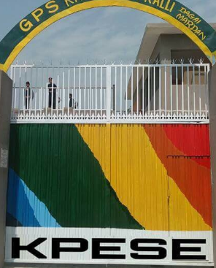
Collective identity one example is UNIFORM AND WHAT ABOUT MP
Proposition 3:
A group’s collective identity, as framed by at least some characteristics outside formal institu­tions, strengthens the relationship between entrepreneurial alertness and opportunity recognition in the in formal economy

Slide 38
A MULTILEVEL FRAMEWORK OF THE ENTREPRENEURIAL PROCESS IN THE INFORMAL ECONOMY
Collective Identity and Opportunity Exploitation in the Informal Economy
A group with a strong identity can enhance cooperation among members and provide access to resources and markets.
Informal economy entrepreneurs may gather needed resources from other members of their group through “highly creative ways of acquiring the use of resources without borrowing or raising equity financing from traditional sources” (Freear, Sohl, & Wetzel, 1995: 102).

Slide 39
A MULTILEVEL FRAMEWORK OF THE ENTREPRENEURIAL PROCESS IN THE INFORMAL ECONOMY
Collective Identity and Opportunity Exploitation in the Informal Economy
Growth-oriented entrepreneurs in the informal economy pursue opportunities beyond their local group of family, ethnic enclave, or community.
Proposition 4: A group’s collective identity, as framed by at least some characteristics outside formal institutions, strengthens the relationship between opportunity recognition and op­portunity exploitation in the informal economy

Slide 40
A MULTILEVEL FRAMEWORK OF THE ENTREPRENEURIAL PROCESS IN THE INFORMAL ECONOMY
Growth and Transition of Informal Economy Ventures
The growth of ventures in the informal economy creates a paradox.
On the one hand, growth allows successful entrepreneurs to enjoy gains in wealth; on the other, growth increases the possibility of detection by enforcement agents.
Entrepreneurs pursuing illegal yet legitimate ends feel greater pressure to fully transition to the formal economy than those exploiting illegal yet legitimate means.

Slide 41
A MULTILEVEL FRAMEWORK OF THE ENTREPRENEURIAL PROCESS IN THE INFORMAL ECONOMY
Growth and Transition of Informal Economy Ventures
Innovation theory logic suggests that, in general, means are less imitable because they take place behind closed doors; in contrast,
End products are distributed within a market where both competitors and enforcement agents can study them.

Slide 42
A MULTILEVEL FRAMEWORK OF THE ENTREPRENEURIAL PROCESS IN THE INFORMAL ECONOMY
Growth and Transition of Informal Economy Ventures
Proposition 5: Although informal economy ventures exploiting illegal yet le­gitimate ends feel more pressure to transition to the formal economy, the probability of successful transition for informal economy ventures exploiting illegal yet legitimate means is greater.

Slide 43
Conclusion
First, the study suggested that the incongruence between formal and informal institutions creates the potential for an informal economy.
In contrast to the formal economy, means and/or ends are illegal yet legitimate in the informal economy.
The paper proposed that incongruence between formal and informal institutions strengthens the relationship between entrepreneurial alertness and opportunity recognition in the informal economy.

Slide 44
Conclusion (Cont…)
Additionally, weak enforcement of formal laws and regulations enhances the relationship between opportunity recognition and exploitation in the informal economy.
The potential of collective identity, which provides the meso-level effects in the model, to facilitate the entrepreneurial process in the informal economy.
The paper final proposition explored the transition of entrepreneurial ventures from the informal to the formal economy.

Slide 45
Conclusion (Cont…)
A longer-term approach to managing the informal economy is to modify informal institutions.
To be effective, such actions would ideally target specific beliefs that support entrepreneurial activities in the informal economy, rather than the values and norms defining collective identities.
Policies formed and implemented for these purposes should seek additional congruence between formal and informal institutions.

Slide 46
Summary Contributions
Several theoretical contributions and policy implications result from this work. First, inte­grating different social disciplines to explain the use of the entrepreneurial process in the informal economy contributes to an emerging theory of entrepreneurship (Phan, 2004).

Slide 47
Summary Contributions
Second, we enhance institutional theory by describing how opportunities arise within the informal economy, as well as why entrepreneurs can effectively pursue some of those opportunities. In doing so we answer calls for multidimensional perspectives regarding institutions (Glynn, Barr, & Dacin, 2000).

Slide 48
Summary Contributions
Third, contribute to identity theory by describing how an entrepreneur’s col­lective identity facilitates opportunity recogni­tion and exploitation in the informal economy. Finally, from a policy-making perspective, we inform efforts taken to develop policies that
(1) more effectively encourage entrepreneurs to use the entrepreneurial process in the formal econ­omy and
(2) influence entrepreneurs’ transitions from the informal economy to the formal economy.

Slide 49
Thank You !
.

